Slide 1
Assembly Language Programming
Basic Addition and Binary Encoding
Department of Computer Science and Engineering
Amrita School of Engineering
Coimbatore
Data Processing Instructions

Slide 2
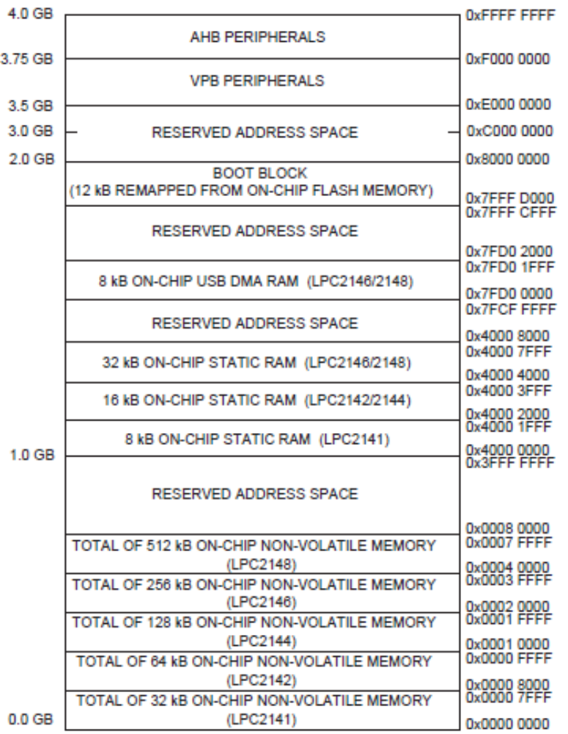
Memory Map – LPC2148
Data
RAM
(Data Memory)
Program
Flash ROM
(Code M/M)
Data Processing Instructions

Slide 3
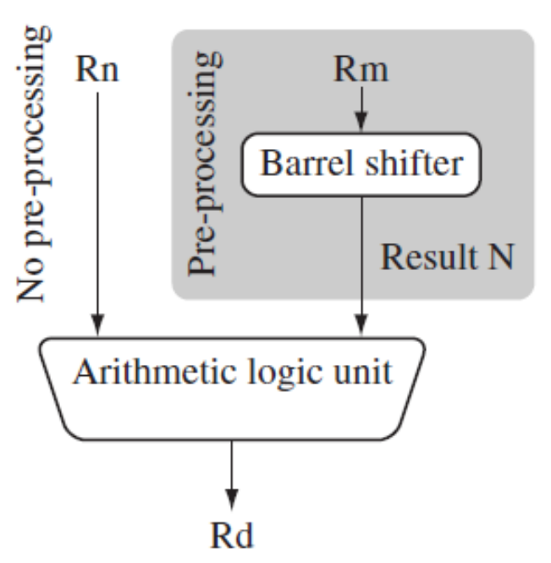
Example Code
Assembly Language Program to add two numbers
AREA
ENTRY
MOV R1,#1
MOV R2,#2
ADD R0,R1,R2
END
CODE,
READONLY
ADDITION,
Assembler Directive
R1
1
R2
2
+
R0
3
Data Processing Instructions

Slide 4
Example Code
Assembly Language Program to add two numbers
AREA
ENTRY
MOV R1,#1
MOV R2,#2
ADD R0,R1,R2
STOP B STOP
END
CODE,
READONLY
ADDITION,
 | Program M/M
0X00000000 | MOV R1,#1
0X00000004 | MOV R2,#2
0X00000008 | ADD R0,R1,R2
0X0000000C | B 0X0000000C
Short Jump
0X0000000C
0X00000010
……..
Label
Data Processing Instructions

Slide 5
Data Processing
Instructions
Binary Encoding
Department of Computer Science and Engineering
Amrita School of Engineering
Coimbatore
Data Processing Instructions

Slide 6
Binary Encoding
SUBEQS R0,R1,#2
31 | 30 | 29 | 28 | 27 | 26 | 25 | 24 | 23 | 22 | 21 | 20 | 19 | 18 | 17 | 16 | 15 | 14 | 13 | 12 | 11 | 10 | 9 | 8 | 7 | 6 | 5 | 4 | 3 | 2 | 1 | 0
0 | 0 | 0 | 0
0 | 0
1
0 | 0 | 1 | 0
1
0 | 0 | 0 | 1
0 | 0 | 0 | 0
0 | 0 | 0 | 0
0 | 0 | 0 | 0 | 0 | 0 | 1 | 0
Data Processing Instructions

Slide 7
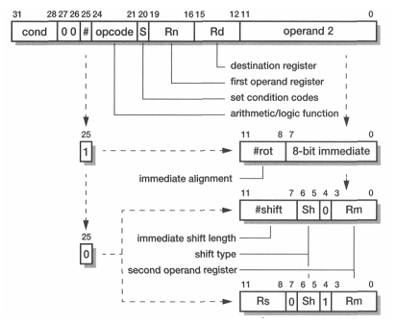
Data Process – Binary Encoding
SUBEQS R0,R1,#2
Data Processing Instructions

Slide 8
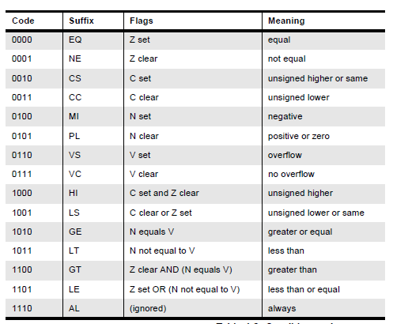
Data Process – Binary Encoding
Condition Codes
Data Processing Instructions

Slide 9
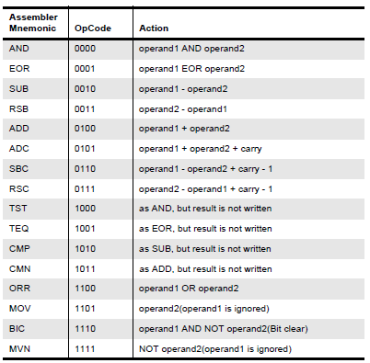
Data Process – Binary Encoding
Opcodes
Data Processing Instructions

Slide 10
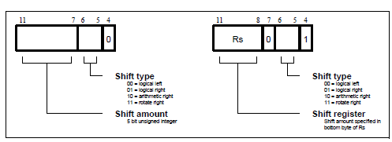
Data Process – Binary Encoding
Shifts
Data Processing Instructions

Slide 11
Data Process – Binary Encoding
SUBEQS R0,R1,#2
31 | 30 | 29 | 28 | 27 | 26 | 25 | 24 | 23 | 22 | 21 | 20 | 19 | 18 | 17 | 16 | 15 | 14 | 13 | 12 | 11 | 10 | 9 | 8 | 7 | 6 | 5 | 4 | 3 | 2 | 1 | 0
0 | 0 | 0 | 0
0 | 0
1
0 | 0 | 1 | 0
1
0 | 0 | 0 | 1
0 | 0 | 0 | 0
0 | 0 | 0 | 0
0 | 0 | 0 | 0 | 0 | 0 | 1 | 0
4 Bit
Cond. Code
Im.
Op.
4 Bit
Opcode
S
Rn
Op. 1 Reg.
Rd
Desti. Reg.
4 Bit
Imm. ROR
8 bit - Operand 2
Res.
Data Processing Instructions
0X02510002

Slide 12
Data Processing Instr.
ADD R0,R1,R2, LSL#2
31 | 30 | 29 | 28 | 27 | 26 | 25 | 24 | 23 | 22 | 21 | 20 | 19 | 18 | 17 | 16 | 15 | 14 | 13 | 12 | 11 | 10 | 9 | 8 | 7 | 6 | 5 | 4 | 3 | 2 | 1 | 0
1 | 1 | 1 | 0
0 | 0
0
0 | 1 | 0 | 0
0
0 | 0 | 0 | 1
0 | 0 | 0 | 0
0 | 0 | 0 | 1 | 0
0 | 0
0
0 | 0 | 1 | 0
4 Bit
Cond. Code
Res.
Im.
Op.
4 Bit
Opcode
S
Rn
Op. 1 Reg.
Rd
Desti. Reg.
Imm.
Shift Length
Sh.
Ty.
Im.
Sh.
Rm
Op. 2 Reg.
Data Processing Instructions
0XE0810102

Slide 13
Data Processing Instr.
ADD R0,R1,R2, LSL R3
31 | 30 | 29 | 28 | 27 | 26 | 25 | 24 | 23 | 22 | 21 | 20 | 19 | 18 | 17 | 16 | 15 | 14 | 13 | 12 | 11 | 10 | 9 | 8 | 7 | 6 | 5 | 4 | 3 | 2 | 1 | 0
1 | 1 | 1 | 0
0 | 0
0
0 | 1 | 0 | 0
0
0 | 0 | 0 | 1
0 | 0 | 0 | 0
0 | 0 | 1 | 1
0
0 | 0
1
0 | 0 | 1 | 0
4 Bit
Cond. Code
Res.
Im.
Op.
4 Bit
Opcode
S
Rn
Op. 1 Reg.
Rd
Desti. Reg.
Rs Sh.
Len. Reg.
Res.
Sh.
Ty.
Im.
Sh.
Rm
Op. 2 Reg.
Data Processing Instructions
0XE0810312

Slide 14
Thank
You
Data Processing Instructions

